Slide 1
https://lrt.yourlearning.ibm.com/home
Only PeMs (GBS India) and SPOCs (existing List) can use the above nomination link

Slide 2
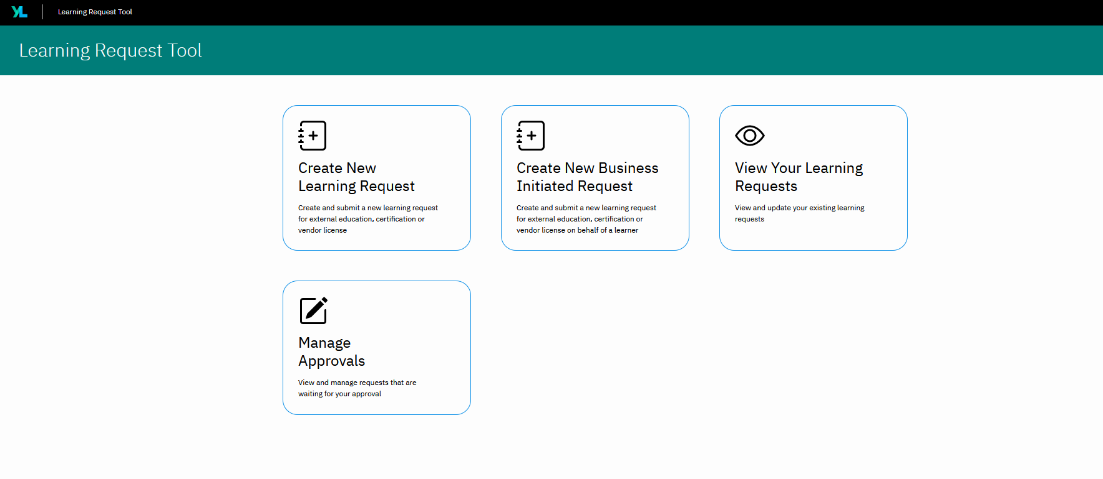
Step1 – Create New Business Initiated Request

Slide 3
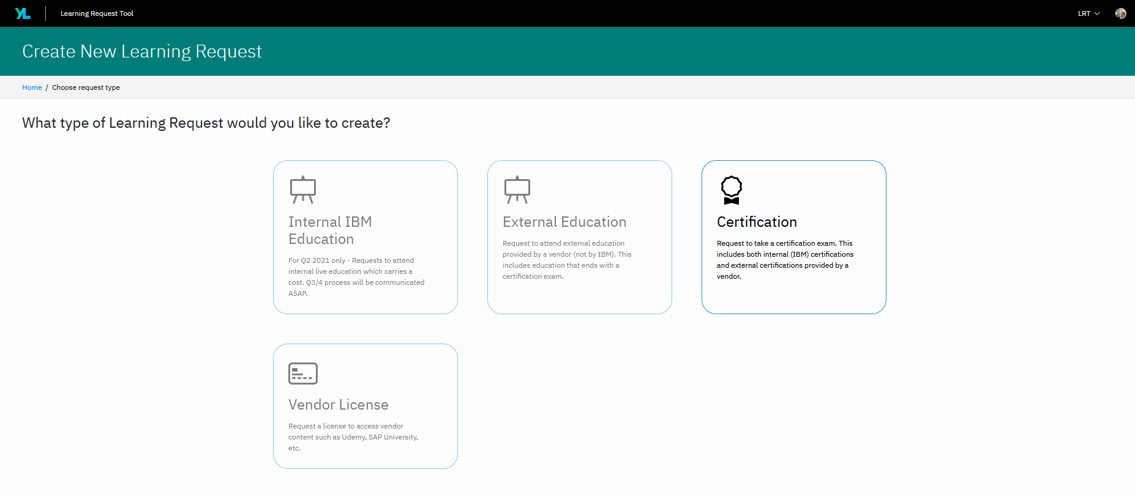
Step 2:- Click on Certification

Slide 4
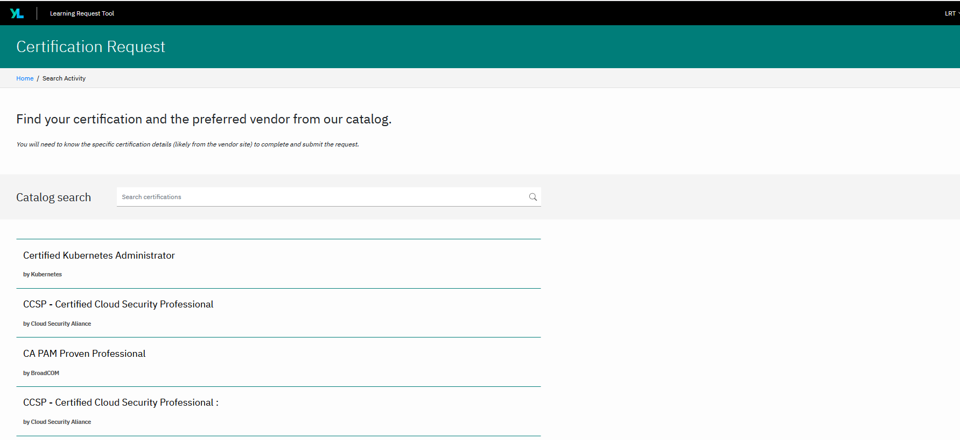
Step 3 :- Type in your certification Name

Slide 5
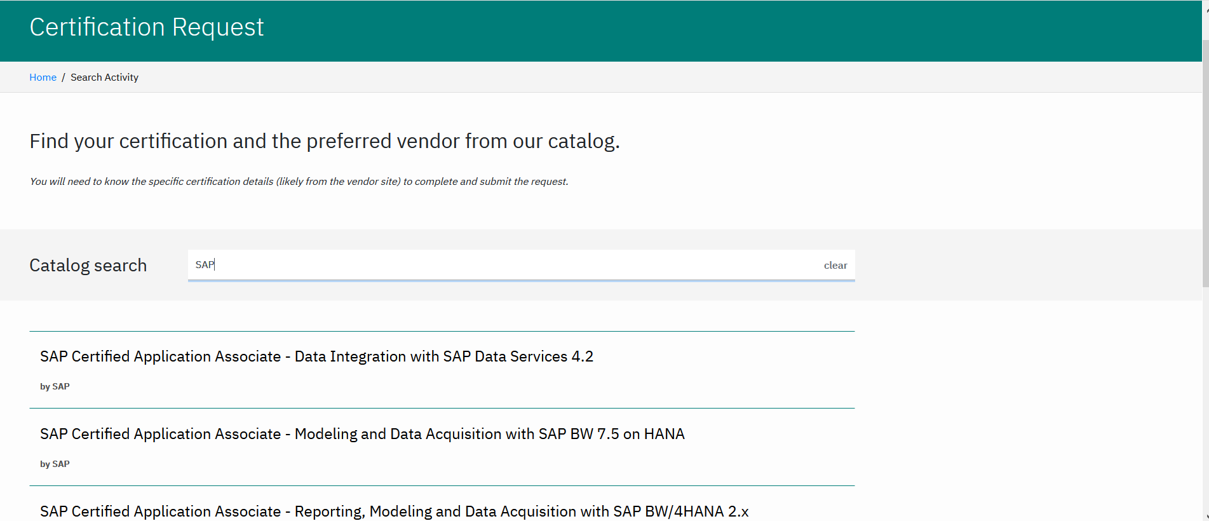
STEP 4 – Select your certification from the List

Slide 6
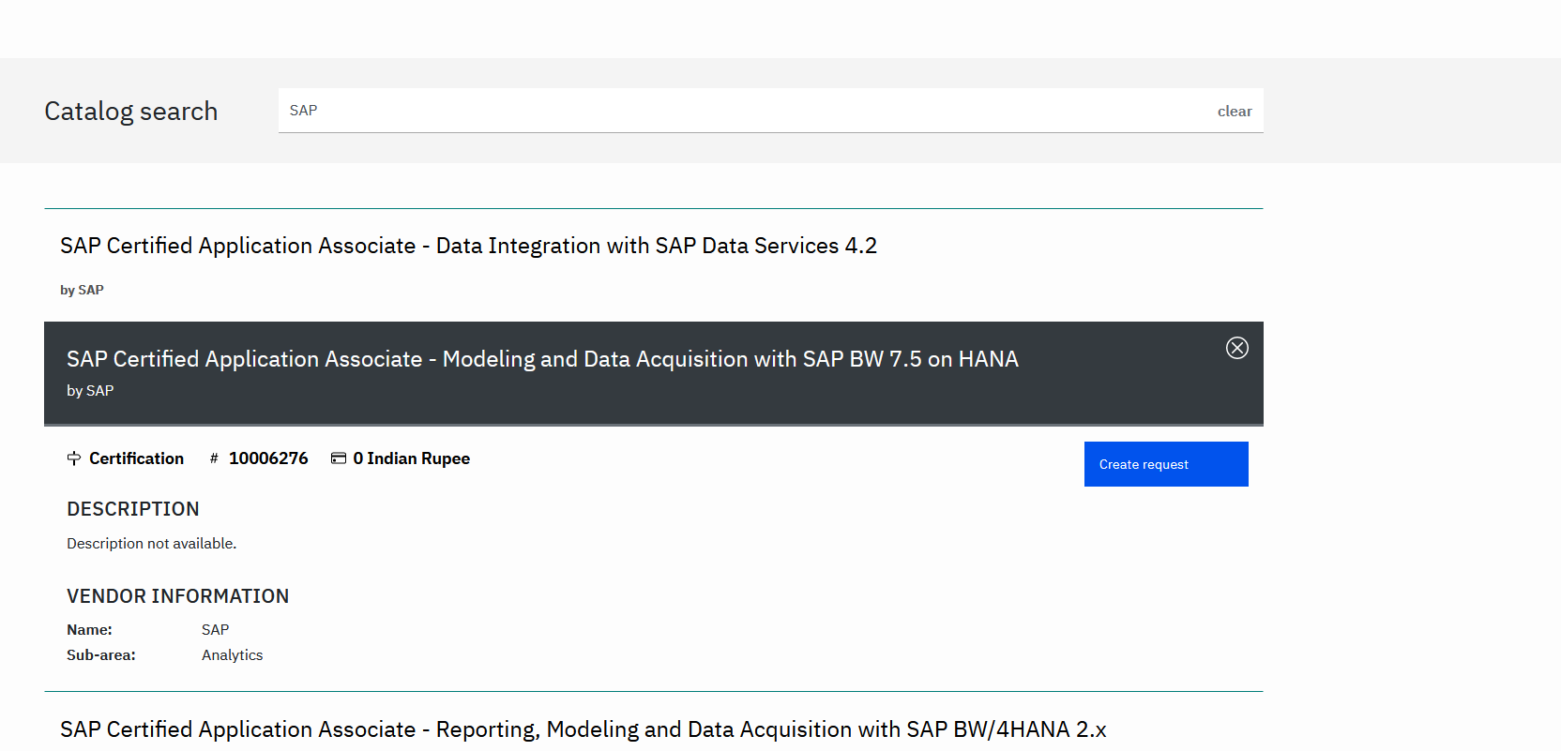
Step 5 – Select certification name and click on Create Request

Slide 7
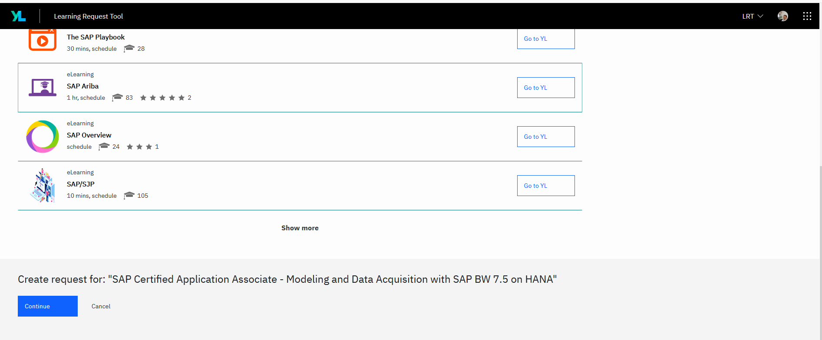
Step 6 :- Scroll down and click on Continue

Slide 8
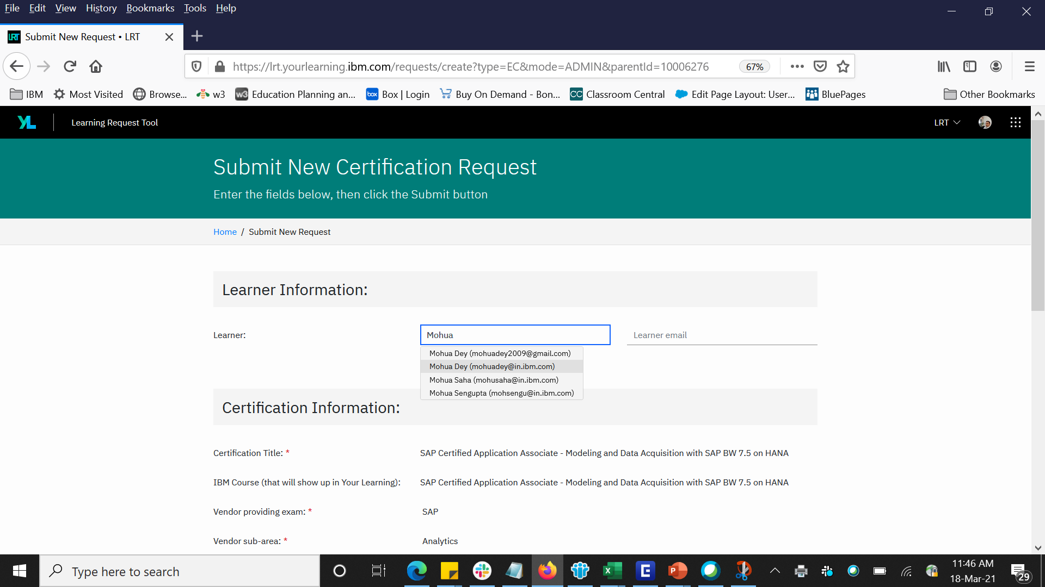
Step 7 :- Type Practitioner Name and select the correct Name- email id will automatically be populated

Slide 9
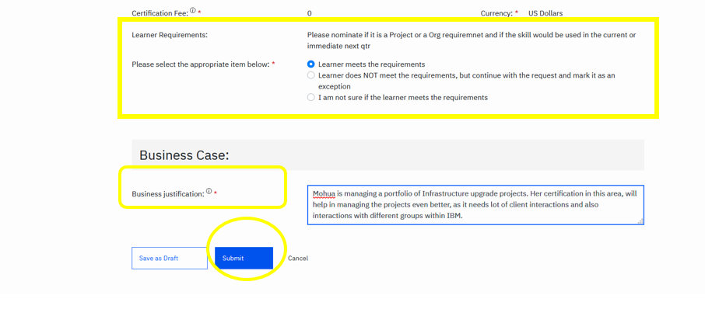
Step 8:- Select the appropriate item below and give Business Justification and click on Submit.

Slide 10
If you have any queries, you can log in your query at - http://ibm.biz/iohelpdesk_app. It will be answered in 24 hrs.
Webex Link - https://ibm.webex.com/meet/mohuadey will be open every day (Tues & Thursdays)
between 10:30 AM to 11:30 AM for any queries/ issues with nomination process.
Check out the catalogue- https://w3.ibm.com/services/lighthouse/spaces/view/learning-knowledge-cic-india/certification
Please nominate only if you are certain that practitioner will take the certification within March 2022
Please note AWS/Google/IBM Cloud nominations will be validated by SL & Sector Leads , if approved will be provided with vouchers. Landed practitioners if approved will be provided with BF approval.
Please note SAP nominations will be validated by SALs , if approved will be provided with vouchers
For certifications where L&K does not provide vouchers , practitioners should go ahead only if they receive the Business Finance approvals and guidance from L&K
Only GBS India practitioners can be nominated – HCAM & Contractors will not be L&K funded.
You can also check the approval status of your nominations on the same LRT tool

